Slide 1
T – Test and Z – Test

Slide 2
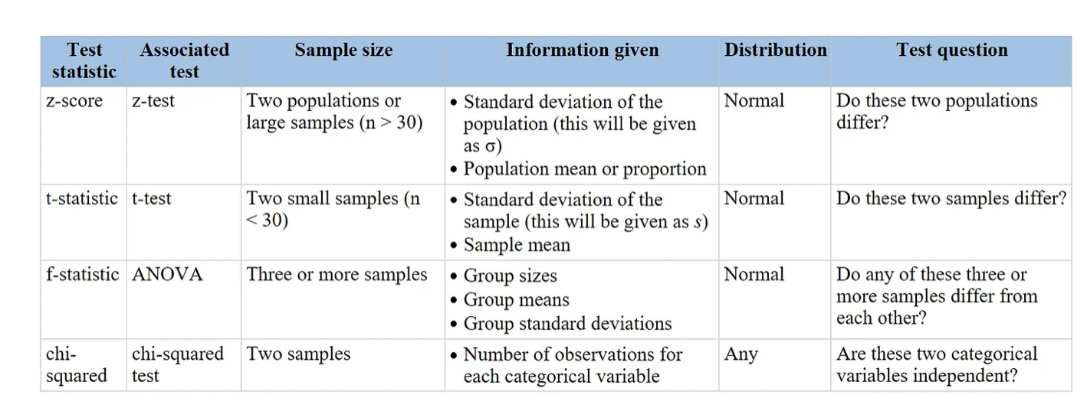
https://medium.com/@marin892/test-statistic-cheat-sheet-z-t-f-and-chi-squared-58f4d9db5b99

Slide 3
How and when to use T – Table?
T- table is used when the sample size is less than 30.
To use the t-distribution table, you only need to know three values:
The degrees of freedom of the t-test
The number of tails of the t-test (one-tailed or two-tailed)
The alpha level of the t-test (common choices are 0.01, 0.05, and 0.10)
When you conduct a t-test, you can compare the test statistic from the t-test to the critical value from the t-Distribution table. If the test statistic is greater than the critical value found in the table, then you can reject the null hypothesis of the t-test and conclude that the results of the test are statistically significant.

Slide 4
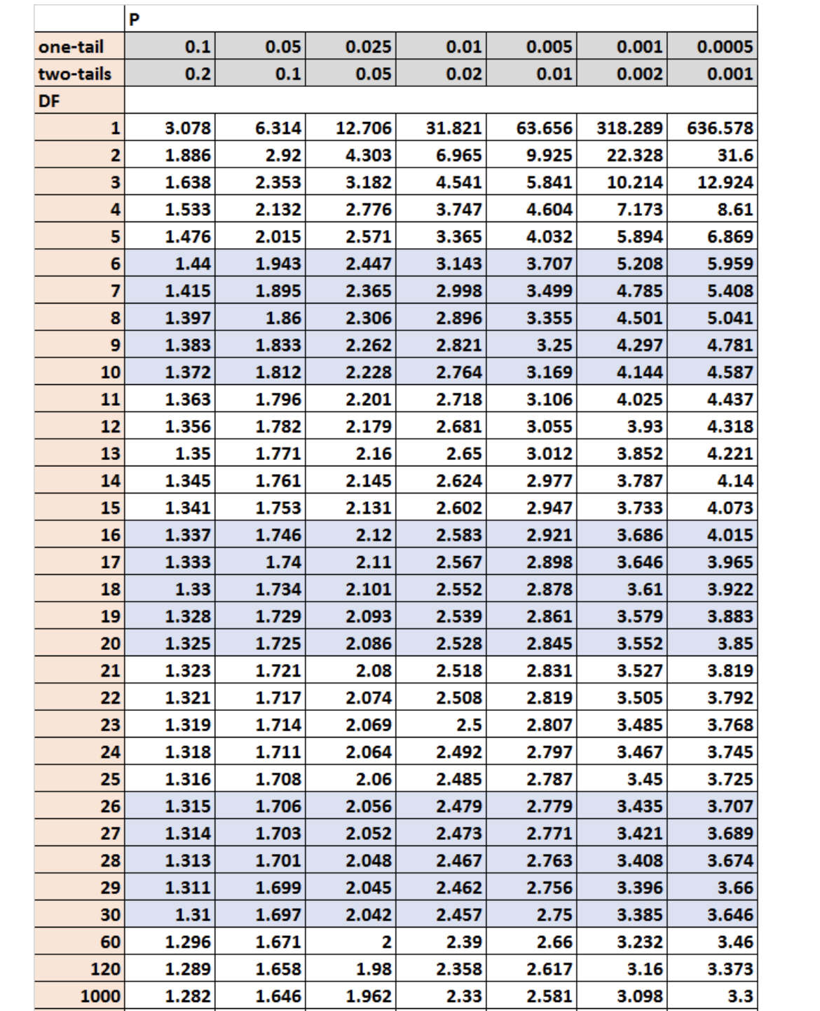

Slide 5
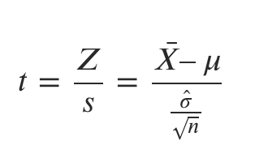
Steps
Step 1: Define the Null Hypothesis (H0) and Alternate Hypothesis (H1)
Step 2: Compute the test statistic (T)

Slide 6
Steps continued
Step 3: Find the T-critical from the T-Table
Use the degree of freedom and the alpha level (0.05) to find the T-critical.
Step 4: Determine if the computed test statistic falls in the rejection region.
Alternately, simply compute the P-value. If it is less than the significance level (0.05 or 0.01), reject the null hypothesis.

Slide 7
One Sample T Test Example
Problem Statement:
We have the potato yield from 12 different farms. We know that the standard potato yield for the given variety is µ=20.
x = [21.5, 24.5, 18.5, 17.2, 14.5, 23.2, 22.1, 20.5, 19.4, 18.1, 24.1, 18.5]
Test if the potato yield from these farms is significantly better than the standard yield.
Solution:
Step 1: Define the Null and Alternate Hypothesis
H0: x̅ = 20
H1: x̅ > 20
n = 12. Since this is one sample T test, the degree of freedom = n-1 = 12-1 = 11.

Slide 8
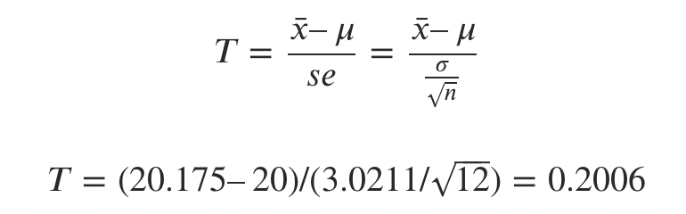
Let’s set alpha = 0.05, to meet 95% confidence level.
Step 2: Calculate the Test Statistic (T) 1. Calculate sample mean
𝑥¯=20.175
Calculate sample standard deviation
𝜎=3.0211
Substitute in the T Statistic formula

Slide 9
Step 3: Find the T-Critical
Confidence level = 0.95, alpha=0.05. For one tailed test, look under 0.05 column. For d.o.f = 12 – 1 = 11, T-Critical = 1.796.
Now you might wonder why ‘One Tailed test’ was chosen. This is because of the way you define the alternate hypothesis. Had the null hypothesis simply stated that the sample means is not equal to 20, then we would have gone for a two tailed test.

Slide 10
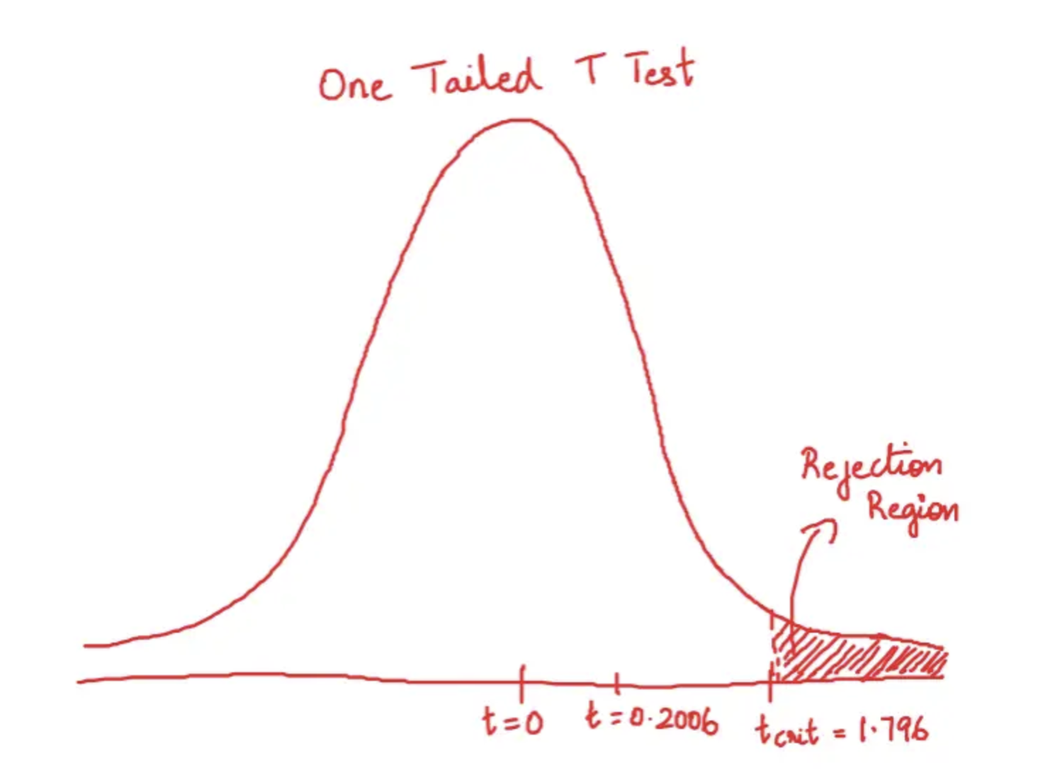
Step 4: Does it fall in rejection region?
Since the computed T Statistic is less than the T-critical, it does not fall in the rejection region.
Clearly, the calculated T statistic does not fall in the rejection region. So, we do not reject the null hypothesis.

Slide 11
Example- One tailed T – test
A researcher recruits 20 subjects for a study and conducts a one-tailed t-test for a mean using an alpha level of 0.05.
Question: Once she conducts her one-tailed t-test and obtains a test statistic t, what critical value should she compare t to?
Answer: For a t-test with one sample, the degrees of freedom is equal to n-1, which is 20-1 = 19 in this case. The problem also tells us that she is conducting a one-tailed test and that she is using an alpha level of 0.05, so the corresponding critical value in the t-distribution table is 1.729.

Slide 12
Example 2
A researcher conducts a two-tailed t-test for a mean using a sample size of 14 and an alpha level of 0.05.
What would the absolute value of her test statistic t need to be in order for her to reject the null hypothesis?
Answer: For a t-test with one sample, the degrees of freedom is equal to n-1, which is 14-1 = 13 in this case. The problem also tells us that she is conducting a two-tailed test and that she is using an alpha level of 0.05, so the corresponding critical value in the t-distribution table is 2.16. This means that she can reject the null hypothesis if the test statistic t is less than -2.16 or greater than 2.16.

